Slide 1

NFL Database Application
Vishnu Bondalakunta
Charles Zumbaugh
James Chapman
Flickr: Barry Schwartz

Slide 2
Overview
Introduction
Demonstration
Discussion
Notes:
I think everybody knows that lithium-ion batteries is a growing technology with a big future. And that batteries have a shelf life.

Slide 3
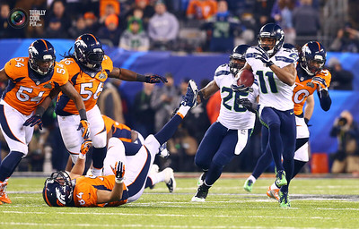
National Football League (NFL)
NFL is a professional American football league
32 teams compete in the NFL
Super Bowl is annual league championship game
Flickr: Molto Torres

Slide 4
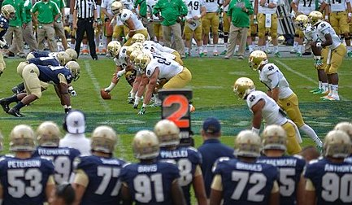
American Football Rules
Games last for 4 quarters of 15 minutes each.
Each team has 4 downs(attempts) to gain 10 or more yards.
Yards are gained by running with ball or passing it to receiver
Down marker showing 2nd down.
Source: US Navy

Slide 5
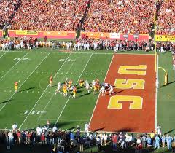
American Football Rules
A play is a plan or strategy used to move the ball down the field.
Pass: Ball thrown by a player
Rush: Running with the ball
Touchdown: Advancing ball to opponent end zone. Worth 6 points
Source: End Zone - Wikipedia

Slide 6
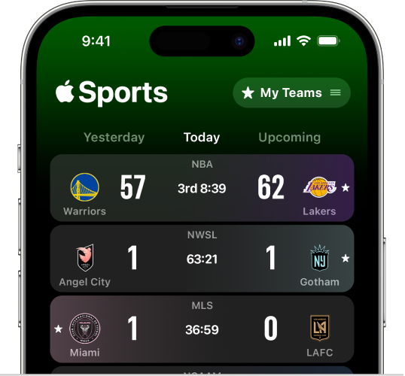
NFL Sports App
Objective: Obtain stats from the NFL games.
Targeted users: Football fans, statisticians.
Possible Applications
Fantasy Football
Sports Betting
Casual information
Source: https://support.apple.com/en-tm/guide/apple-sports-app/apdec6a74b4c/web

Slide 7
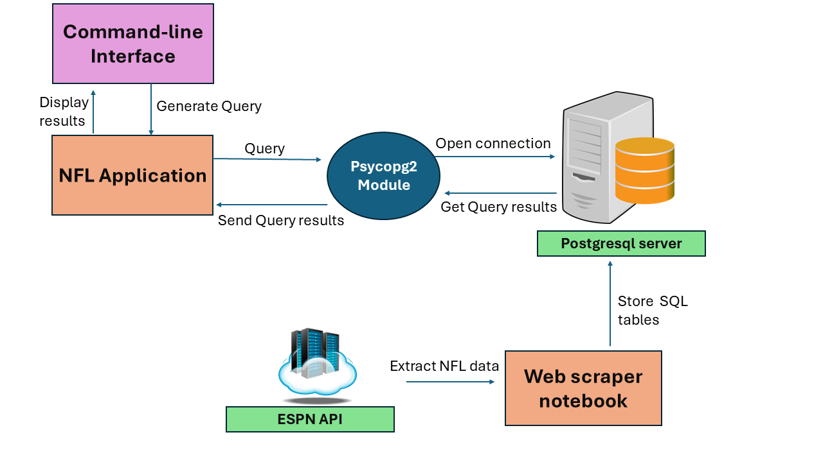
NFL database system implementation
Python application
Extract past 10 years of NFL data from ESPN API

Slide 8
NFL Application Installation
NFL application publicly available at GitHub
https://github.com/JamesChapmanNV/NFL_database
Read the documentation for installation

Slide 9








Data Processing

Slide 10
Schema - 11 tables
Teams (team_name, location, abbreviation, venue_name, primary_color, secondary_color)
Venues (venue_name, capacity, city, state, grass, indoor)
Games (game_id, date, attendance, home_team_name, away_team_name, venue_name, utc_time)
Season_dates (date, season_year, season_type, week)
Athletes (athlete_id, first_name, last_name, dob, height, weight, birth_city, birth_state)
Positions (position_name, abbreviation, platoon)
Rosters (team_name, athlete_id, position_name, start_date, end_date)
Linescores (team_name, game_id, quarter, score)
Plays (play_id, quarter, yards, score_value, play_type, text, seconds_remaining, start_down, end_down)
Player_Plays (play_id, player_id, game_id, type)
Users (uid, username, password, first_name, last_name, created_on, fav_team_name, fav_athlete_id)

Slide 11
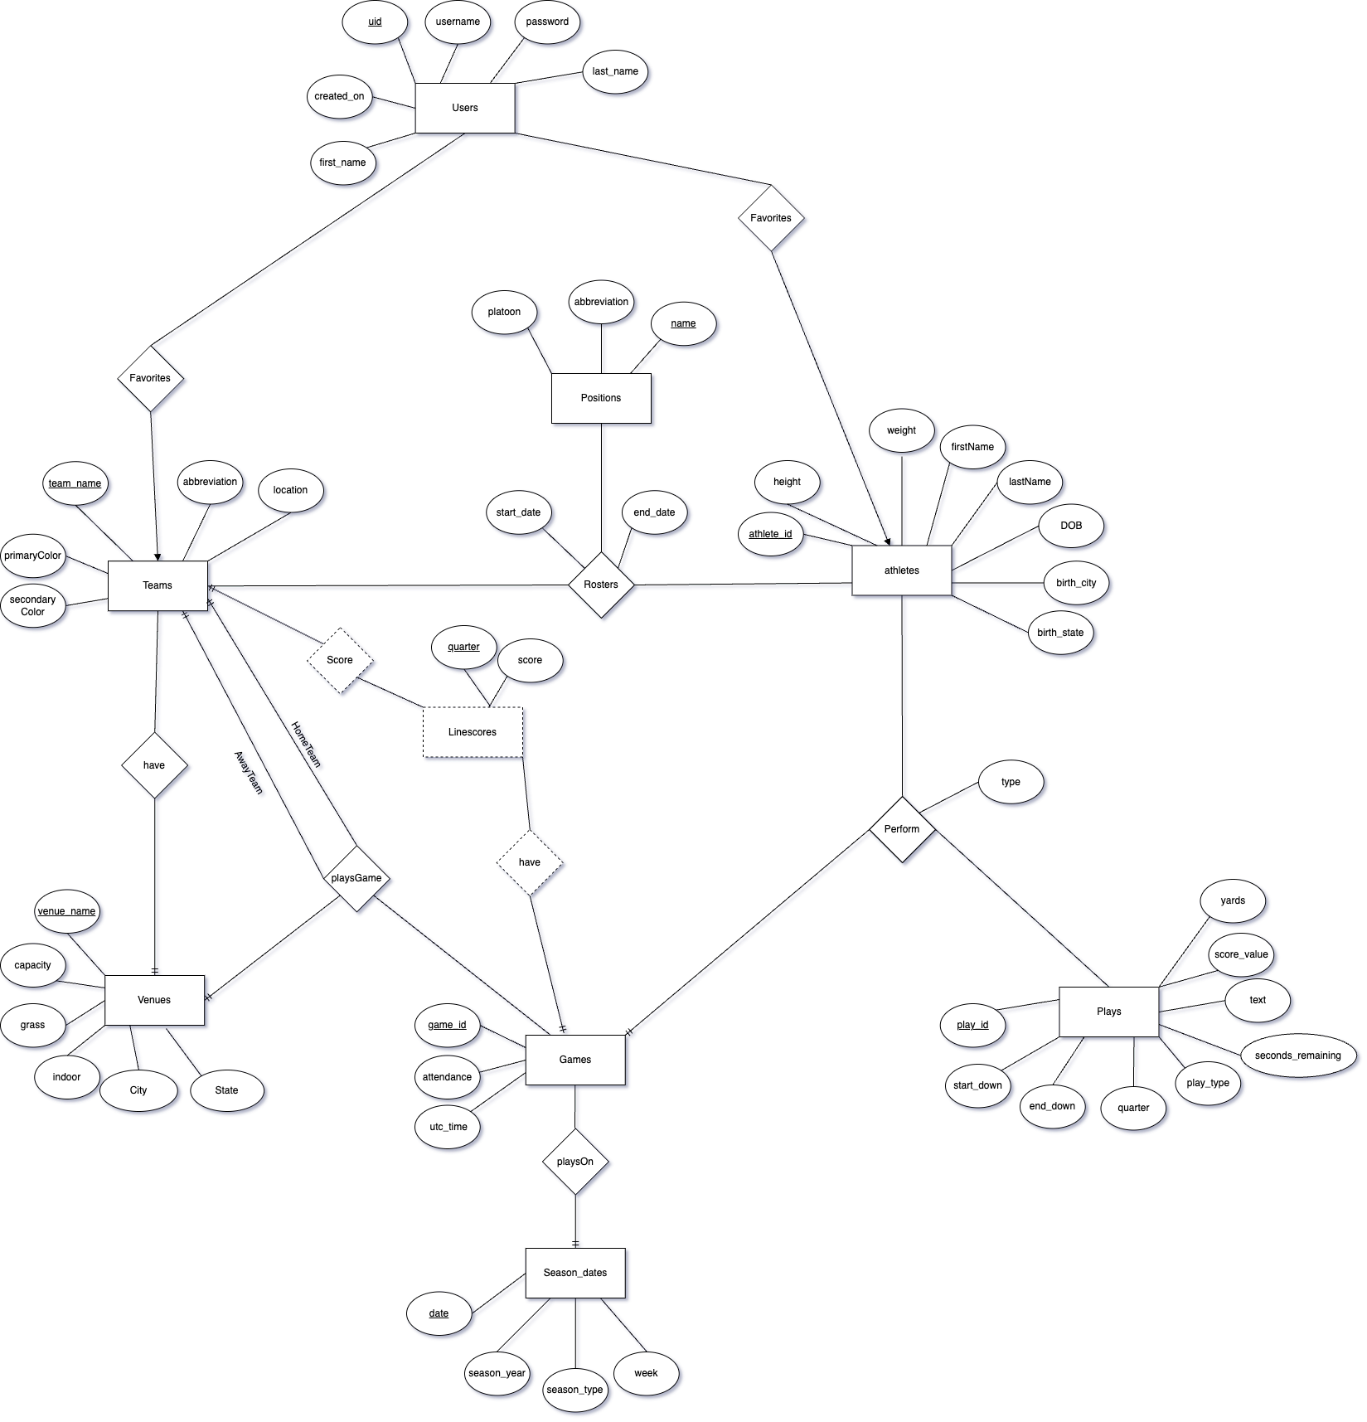
Entity-Relation-Diagram

Slide 12
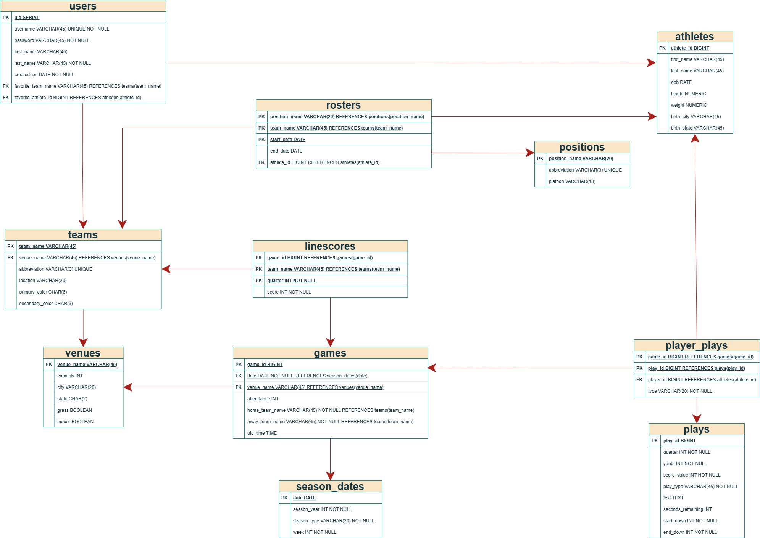

Slide 13
Indexes
QUERY NAME | ms | ms
Attendance | 31.505 | 34.814
Games | 9.602 | 0.415
Players | 10.884 | 11.801
Statistics | 59.195 | 17.559
Top5TeamAttendance | 21.212 | 24.291
TopComebackWins | 43.464 | 44.694
Venue | 0.185 | 0.189
PercentFilled | 0.199 | 0.232
HomeFieldAdvantage | 47.462 | 46.354
TeamRivals | 36.069 | 36.02
WeeklyReceivingStats | 72.203 | 12.807
AthleteReceivingStats | 68.044 | 64.269
FirstQuarterGreater | 22.425 | 23.63
Passing | 91.027 | 85.181
PlayerGamePlays | 59.271 | 0.697
Scores | 20.879 | 5.601
TeamRecords.sql | 54.099 | 52.299
TeamPostSeasonGameCount | 3.789 | 0.769
AvgPtsGrassIndoor | 33.052 | 33.075
Users | 0.142 | 0.115
Win probability | 67.931 | 66.235
CREATE INDEX idx_pp_play_id ON player_plays(play_id); CREATE INDEX idx_pp_game_id ON player_plays(game_id); CREATE INDEX idx_plays_play_id ON plays(play_id); CREATE INDEX idx_athletes_first_name ON athletes(first_name); CREATE INDEX idx_rosters_athlete_id ON rosters(athlete_id); CREATE INDEX idx_linescores_game_id ON linescores(game_id);

Slide 14
NFL Application Walkthrough
Demonstrate the NFL application

Slide 15
NFL Application Walkthrough
Demonstrate the NFL application

Slide 16
NFL Application Walkthrough
Demonstrate the NFL application

